Slide 1
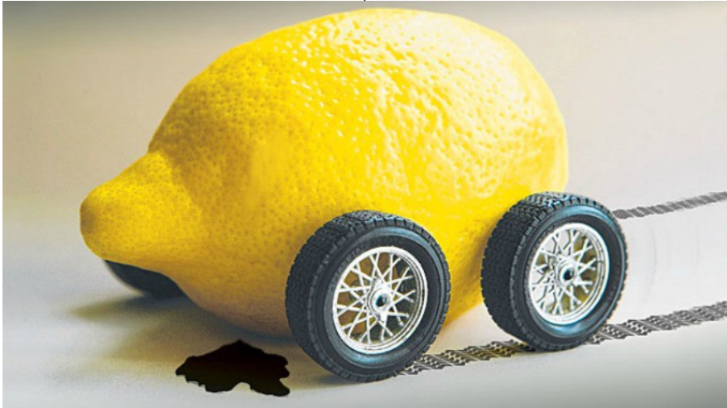
Topic 4: Information
Industrial Organisation / Matěj Bajgar

Slide 2
„The Review does not publish papers on subjects of such triviality.“
Editor, American Economic Review
„If this paper was correct, economics would be different.“
Editor, Journal of Political Economy
George Akerlof (Nobel Memorial Prize 2001) about trying to publish his most famous article
Notes:
By June of 1967 the paper was ready and I sent it to The American Economic Review for publication. I was spending the academic year 1967-68 in India. Fairly shortly into my stay there, I received my first rejection letter from The American Economic Review. The editor explained that the Review did not publish papers on subjects of such triviality. In a case, perhaps, of life reproducing art, no referee reports were included.
Michael Farrell, an editor of The Review of Economic Studies, had visited Berkeley in 1966-67, and had urged me to submit “Lemons” to The Review, but he had also been quite explicit in giving no guarantees. I submitted “Lemons” there, which was again rejected on the grounds that the The Review did not publish papers on topics of such triviality.
The next rejection was more interesting. I sent “Lemons” to the Journal of Political Economy, which sent me two referee reports, carefully argued as to why I was incorrect. After all, eggs of different grades were sorted and sold (I do not believe that this is just my memory confusing it with my original perception of the egg-grader model), as were other agricultural commodities. If this paper was correct, then no goods could be traded (an exaggeration of the claims of the paper). Besides — and this was the killer — if this paper was correct, economics would be different.
I may have despaired, but I did not give up. I sent the paper off to the Quarterly Journal of Economics, where it was accepted.
George Akerlof (Nobel Memorial Prize 2001)

Slide 3

Game
3 sellers, each can produce up to 2 lemons
4 buyers, each buy 1 lemon (or none)
Lemons produced in 3 grades
Grade 1 – lame lemon
Grade 2 – ok lemon
Grade 3 – properly sour lemon
In each round:
First, sellers simultaneously set their grade and quantity for a given round
Second, buyers make purchase decisions in a pre-determined order

Slide 4
Game – discussion
With full information, did grades, prices and quantities converge to some equilibrium?
What was the equilibrium grade and why?
What happenned to the grades, prices and quantities when buyers did observe quality? Why?
What was the effect of the unobserved qualities on welfare?
What do you think would happen in a market where neither buyers not sellers would know quality (a lemon would have a 1/3 chance of being each grade)?
What could the sellers or buyers do to solve the asymmetric information?
Should government regulate the market? How could it do so? What would be the advantages and risks of such regulation?

Slide 5
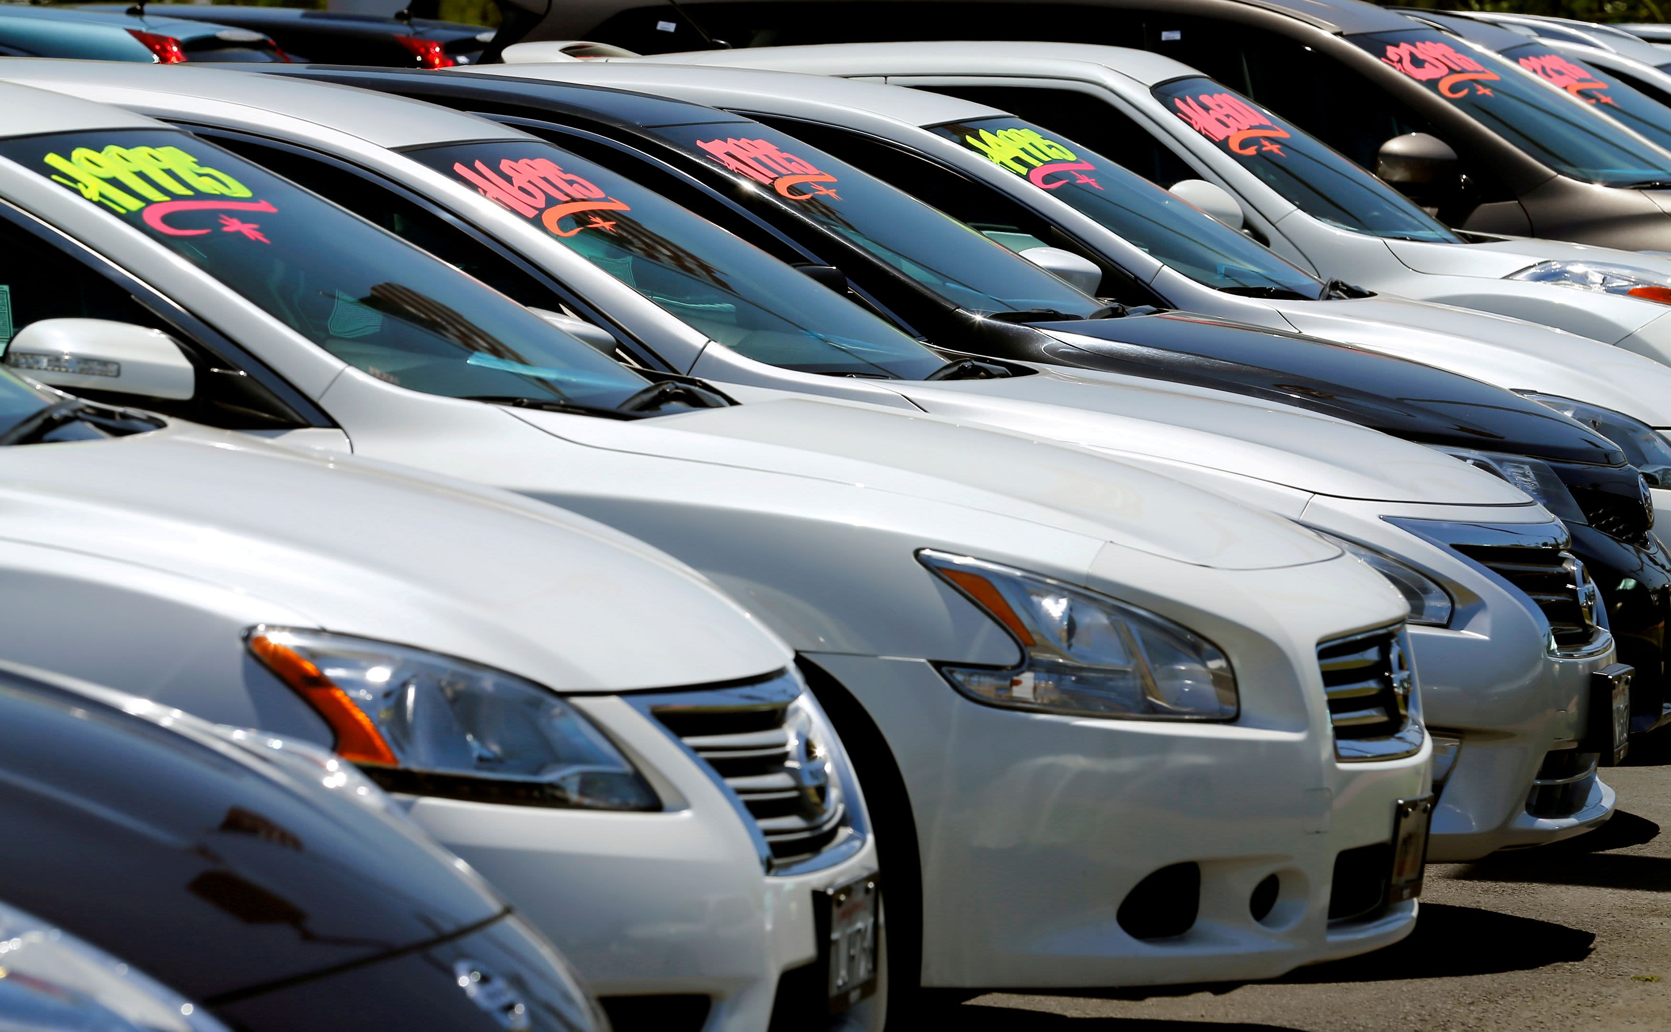


Why should I care?

Slide 6
Dictionnary
Asymmetric information = consumers do not observe quality but firms do
Hidden information problem = asymmetric inform. + quality is a random variable
Hidden action problem = asymmetric inform. + firm chooses quality

Slide 7
Topic outline
Types of asymmetric information problems
Hidden action problems
Hidden information problems
Solutions to asymmetric information
Signalling
Warranties
Branding and reputation

Slide 8
Topic outline
Types of asymmetric information problems
Hidden action problems
Hidden information problems
Solutions to asymmetric information
Signalling
Warranties
Branding and reputation

Slide 9


Hidden action problems - examples

Slide 10
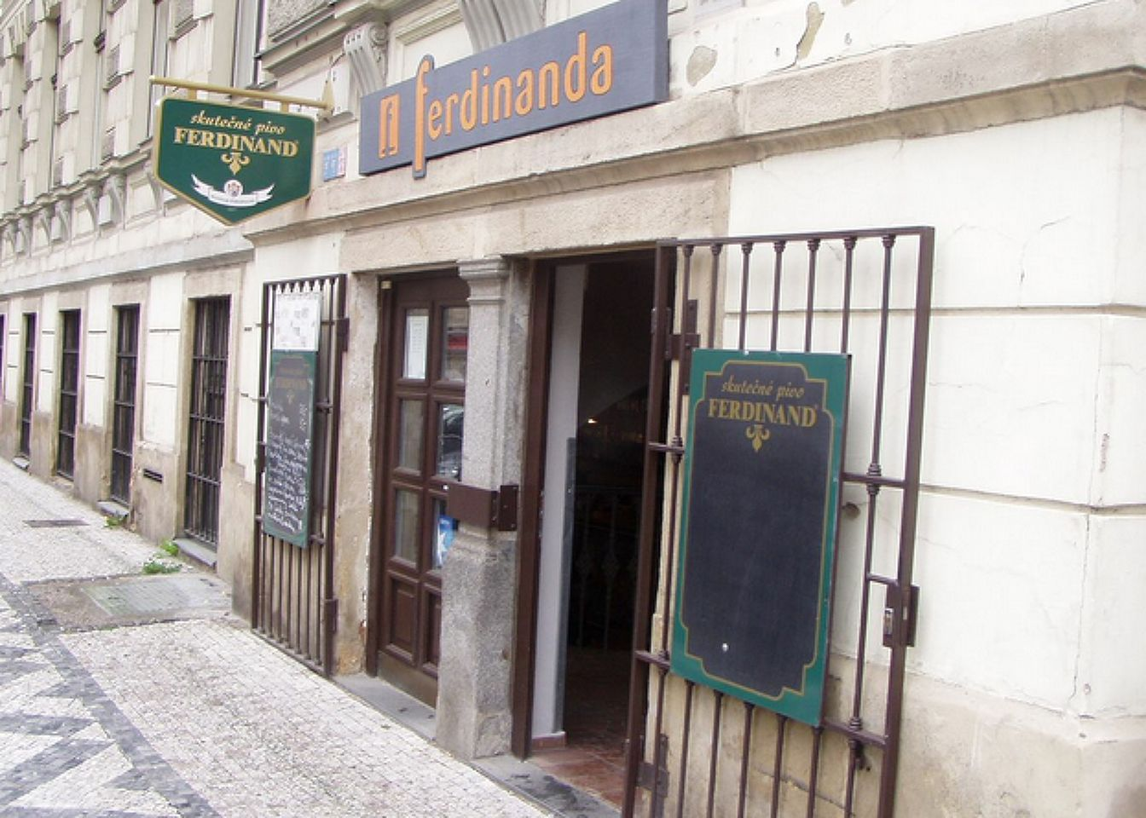
Hidden action problems
One seller chooses between two quality levels
L (low, a “lemon”), produced at cost c_{L}
H (high, a “peach”), produced at cost c_{H}
c_{H} > c_{L}
One potential buyer with willingness to pay r_{H} > r_{L}
Assume: r_{H} > c_{H}, r_{L} > c_{L}➔ with either quality, a profitable trade is possible
3 stages
Firm chooses the quality
Seller decides on the price (or no price)
Consumer decides whether to buy
Note: the game we played was an example of a hidden action problem.

Slide 11
Hidden action problems
Full information case
The firm chooses high-quality IFF r_{H} – c_{H} > r_{L} – c_{L}
Socially optimal

Slide 12
Hidden action problems
Asymmetric information
Suppose r_{H} – c_{H} > r_{L} – c_{L}
Firm would like to choose high-quality and get profits r_{H} – c_{H}
But customers suspect it is trying to get r_{H} – c_{L} by charging p = r_{H} but offering low quality
➔ “moral hazard problem”
Customers not willing to pay more than r_{L} ➔ firm offers low quality
Only low quality available, socially suboptimal

Slide 13
Topic outline
Types of asymmetric information problems
Hidden action problems
Hidden information problems
Solutions to asymmetric information
Signalling
Warranties
Branding and reputation

Slide 14
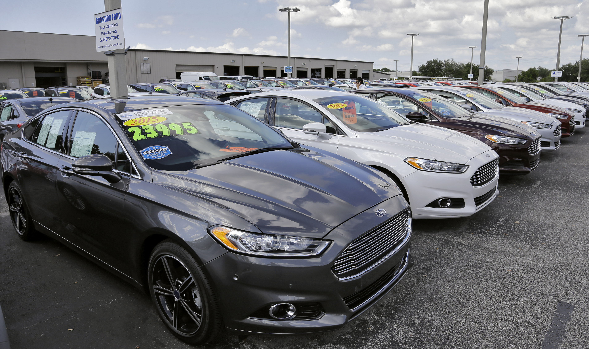
Hidden information problems
One car with 2 possible levels of quality
L (low, a “lemon”)
H (high, a “peach”)
One seller selling one car with opportunity cost c_{s}, s ϵ {L,H}
c_{H} > c_{L} (high-quality car has higher opportunity cost)
One potential buyer with willingness to pay r_{H} > r_{L}
Assume: r_{H} > c_{H}, r_{L} > c_{L}
➔ with either quality, a profitable trade is possible

Slide 15
Hidden information problems
Prices under perfect information
p_{H} = r_{H}, p_{L} = r_{L}
socially optimal

Slide 16
Hidden information problems
Asymmetric information
Only the firm knows the quality of the product
Customer only knows that quality is
high quality with probability λ
low quality with probability 1- λ
➔ Expected utility for buyers = λr_{H} + (1-λ)r_{L}
3 stages
Quality is randomly drawn and the firm observes it
Seller decides on the price (or no price)
Consumer decides whether to buy

Slide 17
Hidden information problems
First assume there will be trade for either quality type
p = λr_{H} + (1-λ)r_{L}
The consumer buys
Pooling equilibrium, as information asymmetry not resolved
Socially optimal
But a high-quality firm selling only if p = λr_{H} + (1-λ)r_{L} > c_{H}
If p = λr_{H} + (1-λ)r_{L} < c_{H}
Re-write as λ(r_{H}-c_{H}) + (1-λ)(r_{L}-c_{H}) < 0
This is the case if r_{L} < c_{H} and 1-λ sufficiently large
High-quality firms will not sell
Consumers realize that and are only willing to pay r_{L}
A low-quality firm sets p = r_{L} and only low-quality products are sold, confirming the belief

Slide 18
Recap: Bayesian Nash equilibrium
Each player is assigned a type by nature (with a probabilistic distribution)
NE: Each player‘s strategy is the best response to all other players‘ strategies.
BNE: Each player‘s strategy is the best response to all other players‘ strategies given their beliefs about the state of the nature.
To see if we have a BNE
Players have no incentive to unilaterally change their strategy
Beliefs are confirmed

Slide 19
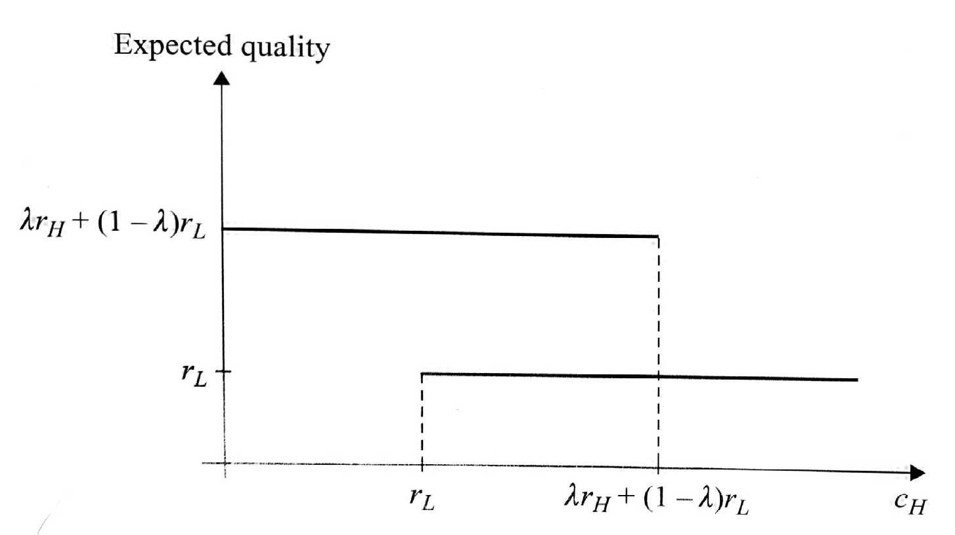
Hidden information problems
The relationship between number of NBEs and model parameters
If c_{H} < r_{L}
The only perfect Bayesian Nash equilibrium is p = λr_{H} + (1-λ)r_{L} independent of quality
If c_{H} > λr_{H} + (1-λ)r_{L}
The only perfect Bayesian Nash equilibrium is p = r_{L} for low-quality firms
not selling for high-quality firms
If r_{L} < c_{H} < λr_{H} + (1-λ)r_{L}
Two equilibria possible
Consumers believe both firm types are selling and this is the case
Consumers believe only low-quality firms are selling and this is the case

Slide 20

Hidden information problems
Imperfect vs. asymmetric information
Assume firms also do not know the quality
What will be the equilibrium?
Then everyone sells at p = λr_{H} + (1-λ)r_{L} as long as λr_{H} + (1-λ)r_{L} > λc_{H} + (1-λ)c_{L}
Socially efficient again
➔ Imperfect information alone is not the problem, the asymmetry is!

Slide 21
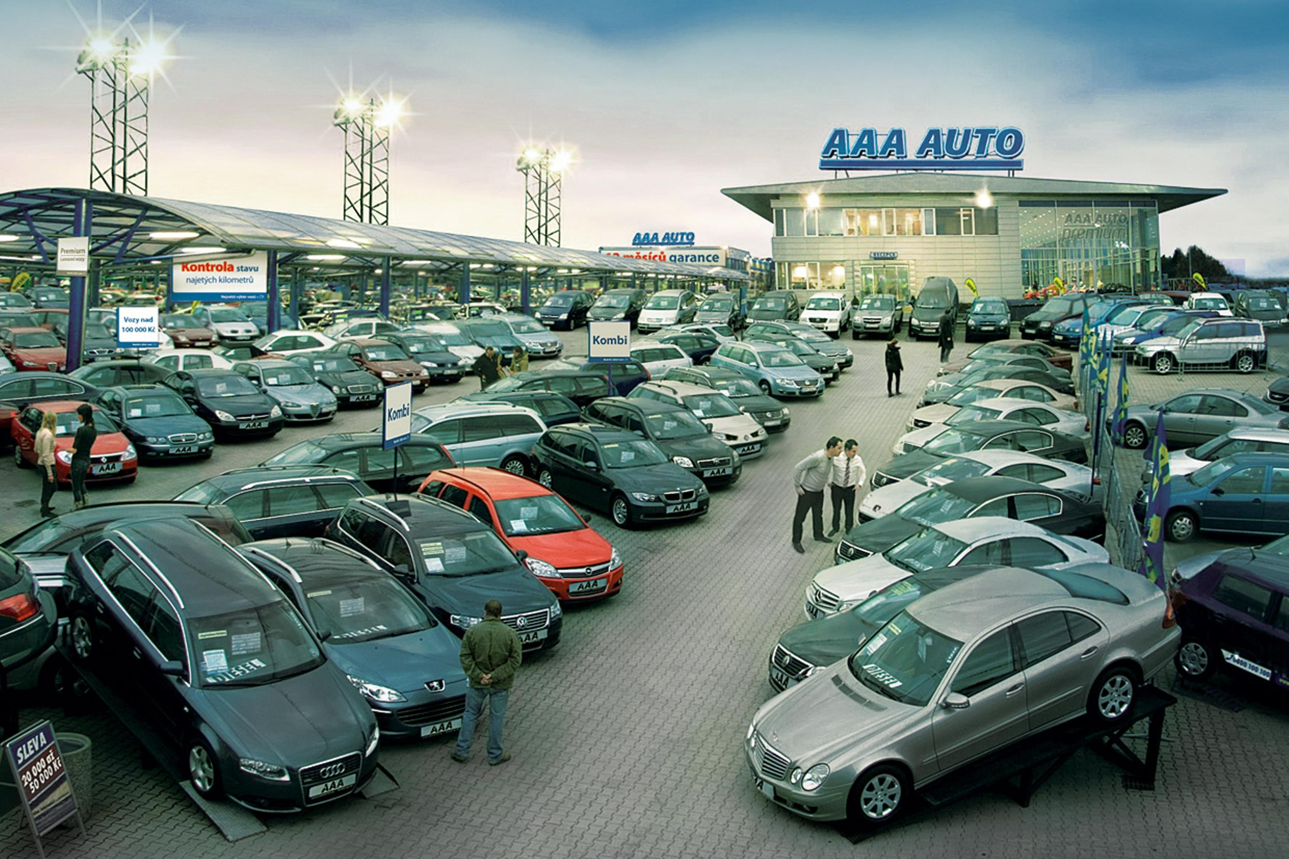
Hidden information problems
Example : Used cars
Owners can
keep their car (outside option)
sell their car
Owners may want to sell their car
Because they want to upgrade to a newer model
Because it has technical issues
Buyers do not know why car sold so only offer low price
➔ Owners who want to upgrade decide to keep their car
➔ Only cars with technical issues available for sale
➔ Many prospective used-car buyers end up buying new cars

Slide 22
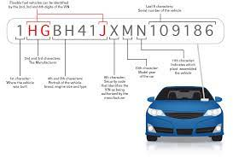



Hidden information problems
Example: Used cars
Solution: Information disclosure:
The high-quality sellers have an incentive to disclose information
But then any sellers not disclosing information are low-quality
➔ All sellers disclose information
Examples: service history, check-up with a mechanic hired by buyer

Slide 23

Hidden information problems
Example: Health insurance
Health insurance public in almost all developed countries (except US). Why?
Here only the buyer knows their condition and expected healthcare costs
The insurance company only knows the distribution of treatment costs
Insurance premium set based on average costs across customers
➔ Low-cost patients choose not to buy
➔ Premium further increases and more patients choose not to buy
➔ Many people without insurance and very high premia

Slide 24

Hidden information problems
Example: Health insurance
Solution: Information disclosure
Set premia based on demographics and pre-existing conditions
BUT what if people change insurance? If premia as high as costs, missing the point of insurance
BUT if people cannot change insurance, missing the point of private markets
Solution: mandatory purchase, premia independent of pre-existing conditions

Slide 25

Deep-tech startups Arora, Fosfuri & Roende (2022)
While IT startups flourish, startups in areas such as new materials, automation and eco-innovation struggle. Why?
Innovative startups generally subject to financing constraints because
Innovations cannot serve as a guarantee (unlike machines, buildings…)
Founders have more information than potential funders/investors ➔ hidden information problems
These problems particularly acute for deep tech startups
They often depend on regulations or complementary infrastructure, which are hard to ensure for startups
Underlying technology difficult and risky and it is often unclear ex-ante who is best placed to commercialise it
This means deep tech firms must overcome technical + commercial challenges
If only technical challenges ➔ startup can commercialise the product on its own
If only commercial challenges ➔ startup can make a contract (VC, acquisition) with large incumbent firm
If technical and commercial challenges ➔ commercialisation challenges reduce threat of startup commercialising the product on its own, and this exacerbates its position vis-à-vis initial investor ➔ acquisition value low relative to social value of startup

Slide 26

Deep-tech startups Arora, Fosfuri and Roende (NBER 2022)
Example: Biomason
The traditional production of cement is energy intensive, and is estimated to account for 8% of global CO2 emissions (https://www.chathamhouse.org/2018/06/making-concretechange-innovation-low-carbon-cement-and-concrete).
Biomason is developing a way to grow cement bricks and tiles with bacteria to replace traditional cement.
Founded in 2012, Biomason has raised $23 million in funding, but has generated less than $10 million in revenue.
Developing the technology was difficult because it relied on engineering bacteria, but there were also commercialization challenges:
“We grew some bricks and thought, ‘Okay, we’ve done it.’ We thought, ‘Okay, somebody is going to be interested in this who knows how to scale the technology and they’re going to do it.’ We realized very quickly that we were going to have to be the ones that did it.”
(Ginger Dosier, CEO, Biomason)

Slide 27
Topic outline
Types of asymmetric information problems
Hidden action problems
Hidden information problems
Solutions to asymmetric information
Signalling
Warranties
Branding and reputation

Slide 28

Solutions: Signalling (education example)
Sometimes sellers can use costly investments to signal their type
1 firm can hire workers for wage w
2 types of workers
High productivity (H) – also high opportunity costs
Low productivity (L) – also low opportunity costs
Only workers know their type
As firms cannot distinguish between the worker types, they pay everyone the same and we have either the pooling or the low-productivity-only equlibrium.

Slide 29
Solutions: Signalling (education example)
Now asume workers can go to university, which carries costs c_{H} and c_{L} per year
Two more or less realistic assumptions
c_{H} < c_{L} (i.e. high-productivity workers find university easier)
No direct productivity benefits of university (i.e. university is a waste of time)
Possible to build an equilibrium where
High-productivity workers attend college for just enough years that low-productivity workers would not be willing to
The firm hires workers who have attended college for a high wage w_{H} and those who have not for a low wage w_{L}
Unproductive workers do not attend college at all because what’s the point?

Slide 30


Solutions: Signalling (education example)
➔ Productive workers signal their productivity by taking a costly (and socially wasteful) action
➔ Unproductive workers do not imitate them (because it would be even more costly)
Note:
An outside observer would see a correlation between university and wage level and incorrectly conclude that university-educated workers are more productive because went to university
But, in fact, they went to university because they are more productive!
In reality, returns to university education are probably (let‘s be optimistic!) a combination of signaling and productivity effects
But returns to education estimated in data likely to overestimate the true productivity effects!

Slide 31
Topic outline
Types of asymmetric information problems
Hidden action problems
Hidden information problems
Solutions to asymmetric information
Signalling
Warranties
Branding and reputation

Slide 32

Solutions: Warranties
Warranties serve many purposes
Warranty can directly tackle the information asymmetry problem
i.e. I am less worried about poor quality if I am guaranteed having my product replaced
But warranties can also serve as signaling device

Slide 33

Solutions: Warranties
Consider the market for TV sets:
Suppose a TV set can either be high or low quality.
High-quality TV set is defective (breaks down) with probability 1 - ρ_{H}
Low-quality TV set is defective with probability 1-ρ_{L} > 1-ρ_{H}
A consumer willing to pay r_{H} for a working TV and r_{L}=0 for a defective one
Firms of either quality have the same costs of making a TV set c
Ex ante, consumers cannot distinguish between a high-quality firm and a low-quality firm
A firm has a 50/50 probability of being high/low quality

Slide 34
Solutions: Warranties
First assume there are no warranties
Consumers do not know the quality
Only willing to pay E(r) = 0.5r_{H}
A pooling equilibrium where firms of either quality charge p = 0.5r_{H} (as long as 0.5r_{H} > c)

Slide 35
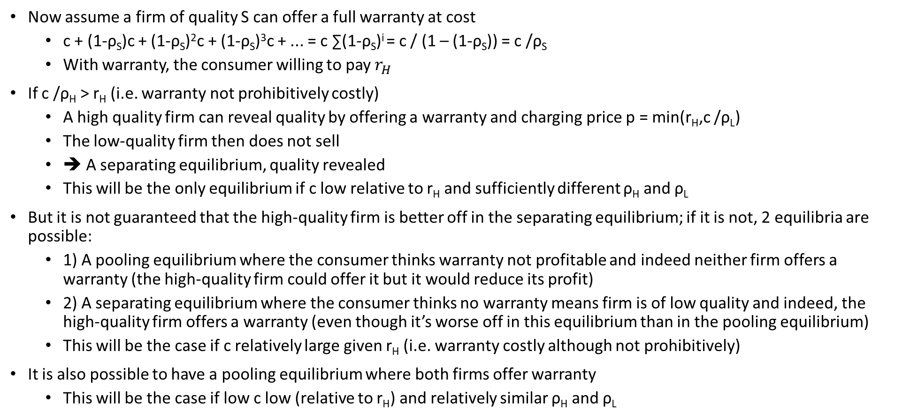
Solutions: Warranties
Now assume a firm of quality S can offer a full warranty at cost
c + (1-ρ_{S})c + (1-ρ_{S})²c + (1-ρ_{S})³c + ... = c ∑(1-ρ_{S})^{i} = c / (1 – (1-ρ_{S})) = c /ρ_{S}
With warranty, the consumer willing to pay $r_{H}$
If c /ρ_{H} > r_{H} (i.e. warranty not prohibitively costly)
A high quality firm can reveal quality by offering a warranty and charging price p = min(r_{H},c /ρ_{L})
The low-quality firm then does not sell
➔ A separating equilibrium, quality revealed
This will be the only equilibrium if c low relative to r_{H} and sufficiently different ρ_{H} and ρ_{L}
But it is not guaranteed that the high-quality firm is better off in the separating equilibrium; if it is not, 2 equilibria are possible:
1) A pooling equilibrium where the consumer thinks warranty not profitable and indeed neither firm offers a warranty (the high-quality firm could offer it but it would reduce its profit)
2) A separating equilibrium where the consumer thinks no warranty means firm is of low quality and indeed, the high-quality firm offers a warranty (even though it’s worse off in this equilibrium than in the pooling equilibrium)
This will be the case if c relatively large given r_{H} (i.e. warranty costly although not prohibitively)
It is also possible to have a pooling equilibrium where both firms offer warranty
This will be the case if low c low (relative to r_{H}) and relatively similar ρ_{H} and ρ_{L}

Slide 36
Exercise: A warranty as a signal of quality
A firm has high-quality (H) or low-quality (L) product
A continuum of consumers
Consumers have willingness to pay
r_{H} = 10 and r_{L} = 4 if the product works
r_{H} = r_{L} = 0 if the product does not work
Quality high/low with probability 50% each (only firm knows the quality)
High-quality breaks with probability 1/5, low-quality with probability 4/5
Fixing a product that does not work costs c
Assume there is no warranty. How much will the consumers be willing to pay?
Suppose the firm can offer a warranty. Under what conditions on replacement costs c can warranty serve as a signal of high quality?
What happens if these conditions are violated?
Compare profits in cases 2 and 3. Comment.

Slide 37
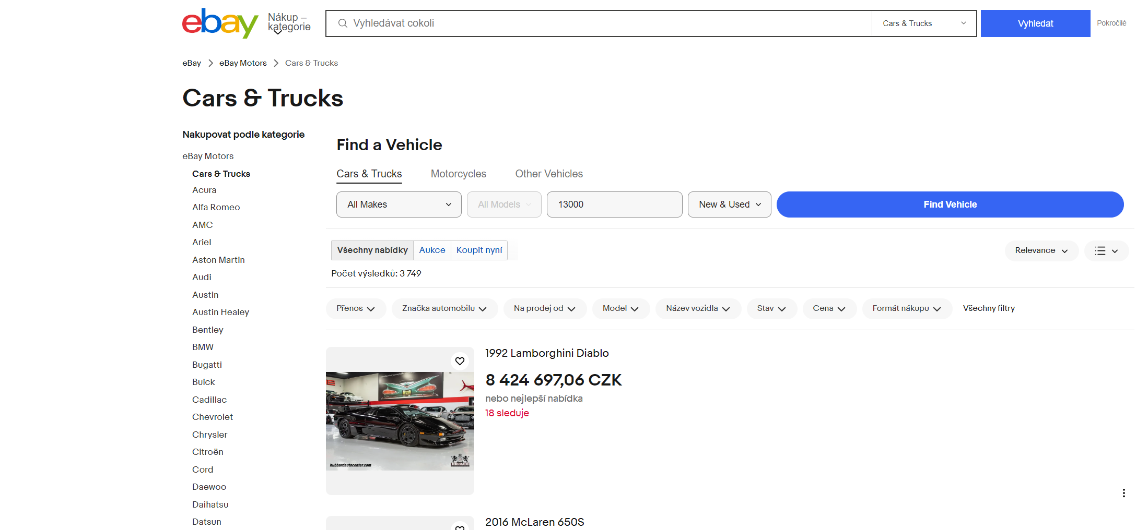
Solutions: Contracting asymmetry away
Example: eBay Motors (Lewis, AER 2011)

Slide 38
Solutions: Contracting asymmetry away
Example: eBay Motors (Lewis, AER 2011)
Online, buyer cannot see the good ➔ should worsen information asymmetries
How come online used-good markets doing so well?
Solution: Warranty contracts
Text/photo/video information on the product
Promise to return money if description not correct
Rating system and other features ensure guarantees enforceable
How to test
Data from eBay for cars
If implicit contracts important, amount of detail in the posting should be correlated with price

Slide 39
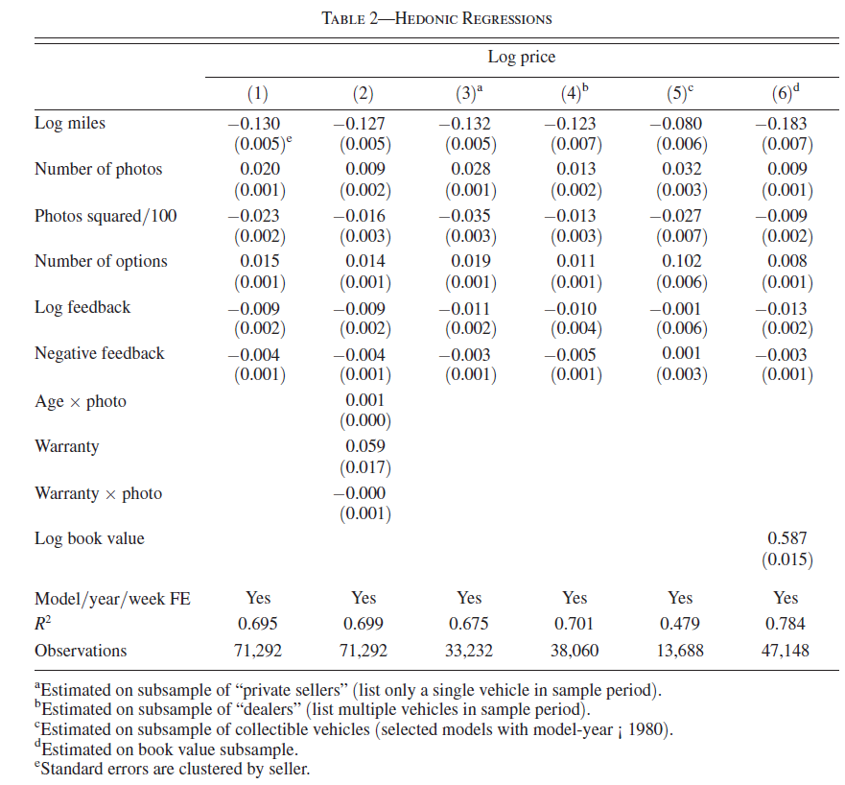
Solutions: Contracting asymmetry away
Example: eBay Motors (Lewis, AER 2011)
Detail in photo descriptions strongly correlated with prices

Slide 40
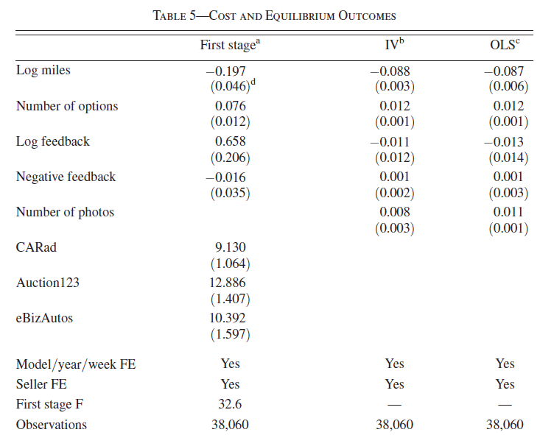
Solutions: Contracting asymmetry away
Example 3: eBay (Lewis, AER 2011)
Lower disclosure costs ➔ more information shared ➔ higher prices

Slide 41
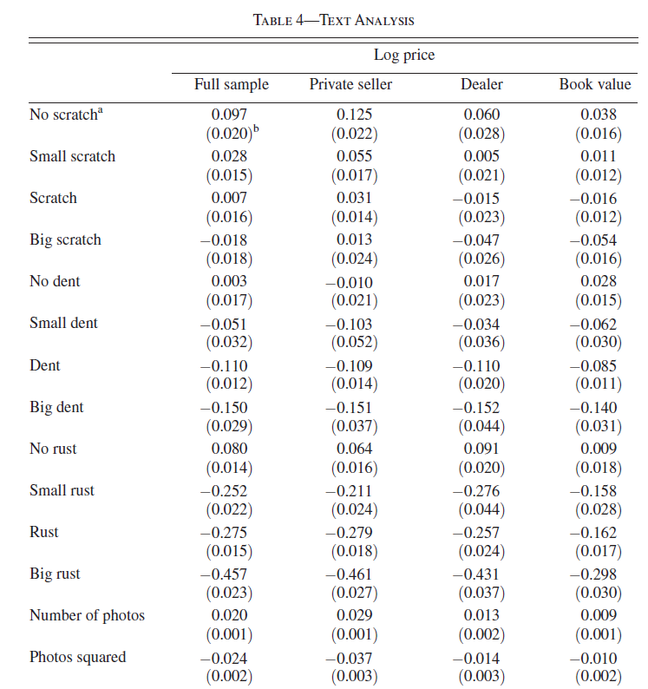
Solutions: Contracting asymmetry away
Example: eBay (Lewis, AER 2011)
Somewhat surprisingly, acknowledging faults worse than not saying anything
Why, then, do sellers disclose them?
Maybe the negative effect of not disclosing already captured by the negative effect of few photos.
Or other factors at play?
Difficulty with enforcing the purchase contract
Reputational risks

Slide 42
Topic outline
Types of asymmetric information problems
Hidden information problems
Hidden action problems
Solutions to asymmetric information
Signalling
Warranties
Branding and reputation

Slide 43
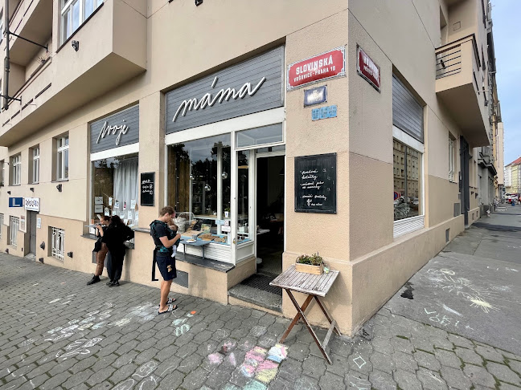
Solution: Branding and reputation
Example: Restaurants
Quality of a restaurant hard to judge ex-ante
Solution: repeated interaction (“tourist hell” vs. “places for locals”)
Solution: reviews (e.g. Tripadvisor)

Slide 44

Solution: Branding and reputation
Another way to signal quality is by repeat interaction
Brand is a tool for turning a one-shot game into a repeated game
One firm deciding to offer high or low-quality product
One customer valuing product as V^{H} if high quality and V^{L} if low quality
The firms has costs c< V^{H} to offer high-quality product and 0 to offer low-quality product
In each period, 2 stages
Firm sets quality and price
Consumers decides whether to purchase

Slide 45
Solution: Branding and reputation
If played only once
In stage 2, it always pays off to offer low-quality product
Consumer knows this so their willingness to pay is V^{L}
Quality is low, p= V^{L} and profits are V^{L}

Slide 46
Solution: Branding and reputation
If infinitely repeated interactions
Discount factor δ
Assume the consumer plays
If high quality in the past (always), purchase if p ≤ V^{H}
If firm cheated before, purchase if p ≤ V^{L}
Assume firm plays
If consumer always purchased, set high quality and p = V^{H}
Otherwise set low quality and p = V^{L}
Is it subgame-perfect equilibrium?
Consumer no interest in deviating (no surplus anyways)
If firm co-operates, it gets V^{H} - c in each period
If it cheats, it gets V^{H} once and V^{L} in all future periods
Firm co-operates IFF V^{H} +∑δ^{t}V^{L} ≤ ∑δ^{t}(V^{H} -c)

Slide 47
Solution: Branding and reputation
For simplicity assume V^{L} =0
Then firm co-operates IFF V^{H} ≤ (V^{H}-c) / (1-δ) ➔ δ ≥ c/ V^{H}
➔ Co-operation if firm sufficiently patient

Slide 48
Exercise: Branding and reputation
A restaurant is deciding whether to offer high-quality or low-quality meals
Customers value a high-quality meal at 200 czk and a low-quality meal at 100 czk.
It costs the restaurant 120 czk to offer a high-quality meal and 50 czk to offer a low-quality meal.
There is an infinite number of periods. In each period, the restaurant offers one (or no) type of meal at some price p and the customers either buy it or not.
The restaurant has a discount factor δ=0.9.
What quality and price will the restaurant offer if it is in a touristy area and knows that people will in any case only come to eat there once (assume no Tripadvisor).
Now assume that the restaurant decides to instead target locals. Also assume the locals expect only the best from the restaurant, but once disappointed, they don‘t give it a second chance. What quality and price will the restaurant offer?
How does the answer to (2) depend on δ?

Slide 49
What is the difference between hidden action problems and hidden information problems
Compare implications of imperfect information and asymmetric information
Name at least 2 explanations for the college premium
How does warranty solve the information asymmetries?
How does branding solve the information asymmetries?
What questions do you have?

